Slide 1
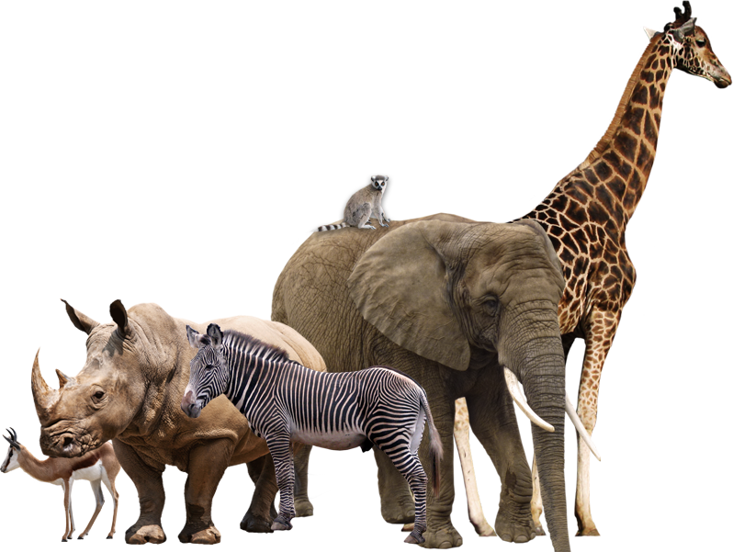
Mammals

Slide 2
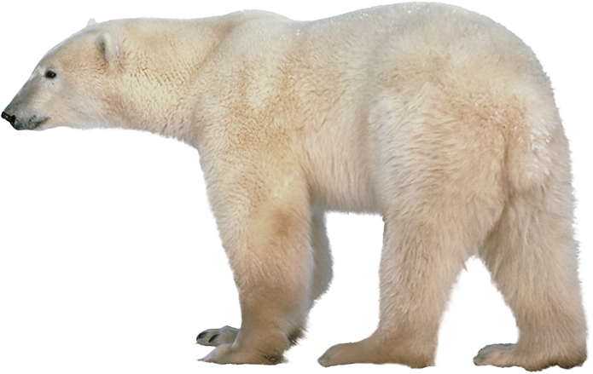
Mammals are covered with hair or fur

Slide 3
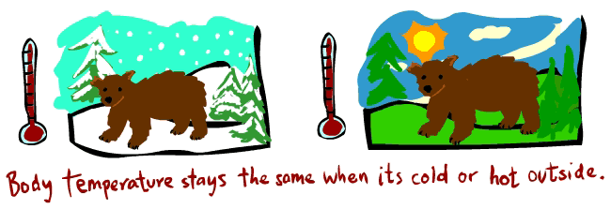
Mammals are warm blooded animals

Slide 4

Mammals breathe through lungs

Slide 5
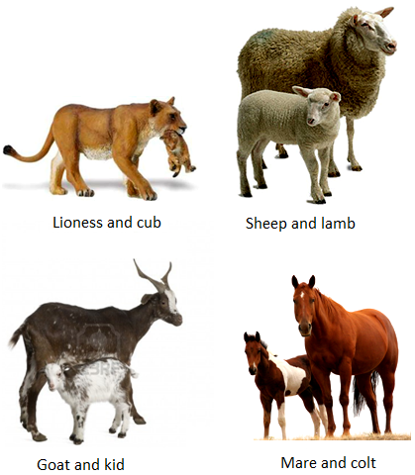
Mammals do not lay egg, they give birth to young ones

Slide 6
Mammals produce milk for their young one

Slide 7
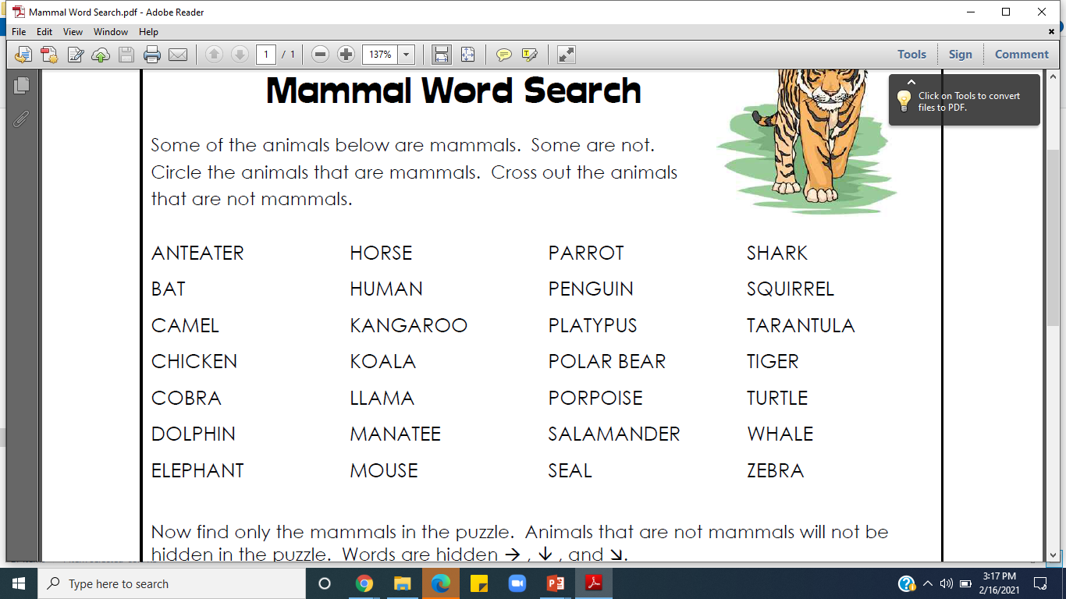
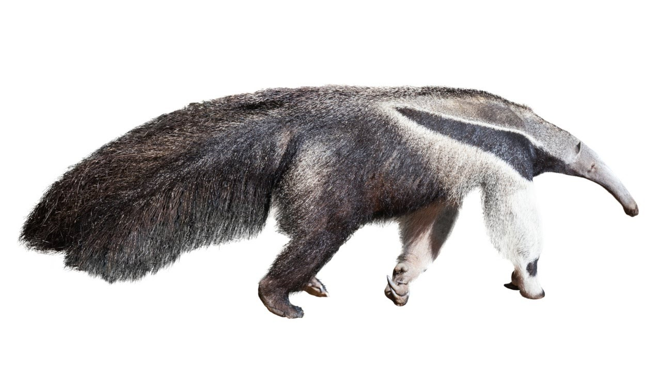
Some of the animals below are mammals. Some are not.
Cross out the animals that are not mammals
Anteaters are mammals that lay egg. It places the egg into a pouch until it hatches.

Slide 8
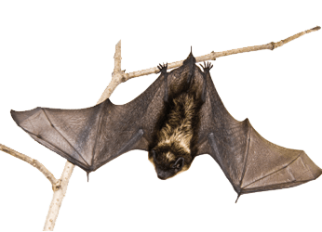
Some of the animals below are mammals. Some are not.
Cross out the animals that are not mammals
Bats are the only mammals that can fly.

Slide 9
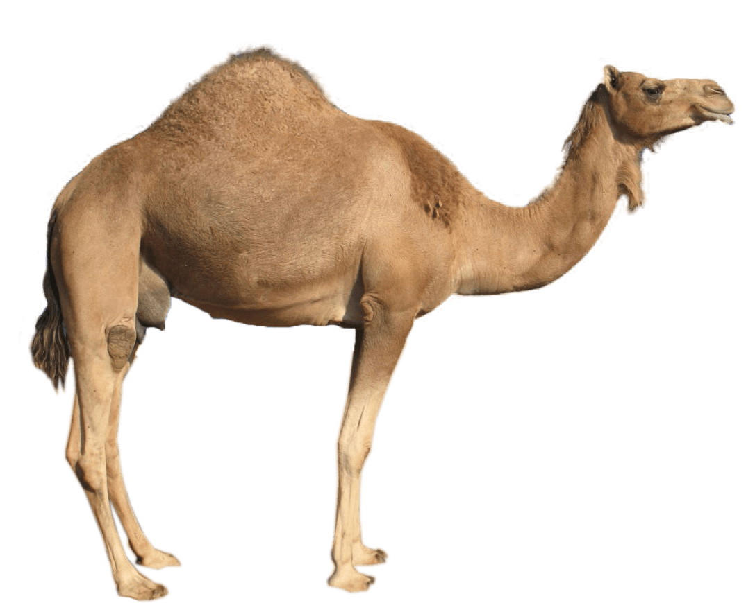
Some of the animals below are mammals. Some are not.
Cross out the animals that are not mammals
Camels are mammals. It is also called as Ship of the desert

Slide 10
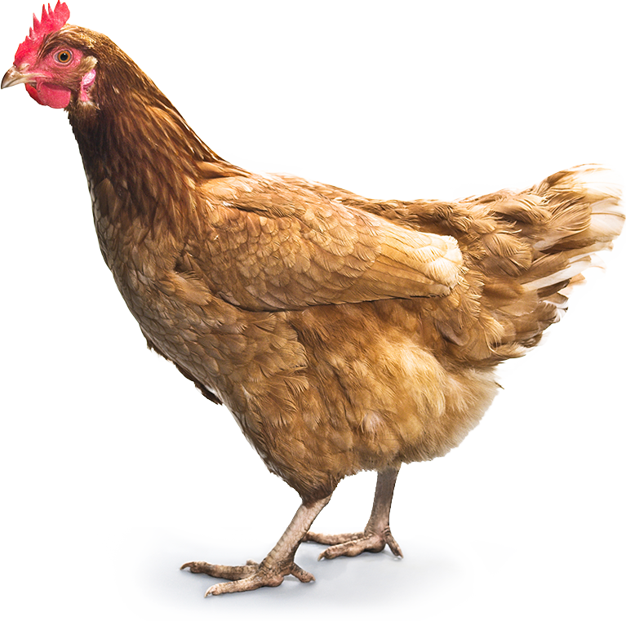
Some of the animals below are mammals. Some are not.
Cross out the animals that are not mammals
Chicken is a bird. It is not a mammal.

Slide 11
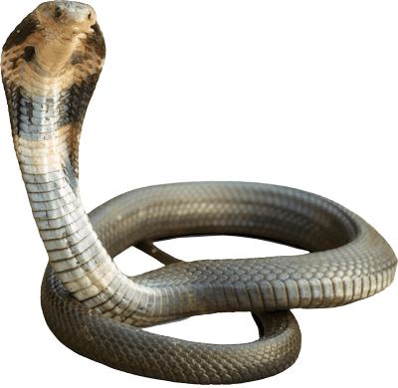
Some of the animals below are mammals. Some are not.
Cross out the animals that are not mammals
Cobra is not a mammal. It moves along the ground and lay eggs. It is a reptile.

Slide 12
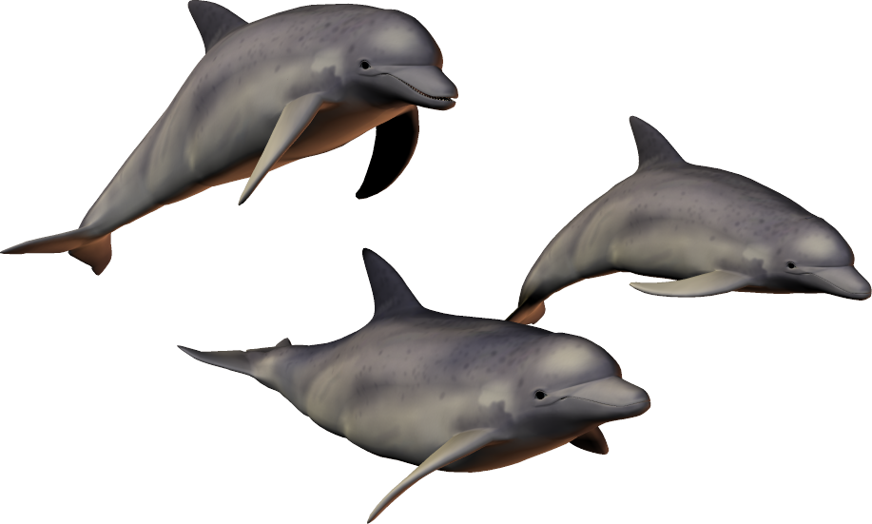
Some of the animals below are mammals. Some are not.
Cross out the animals that are not mammals
Dolphin gives birth to young one. It is a mammal.

Slide 13
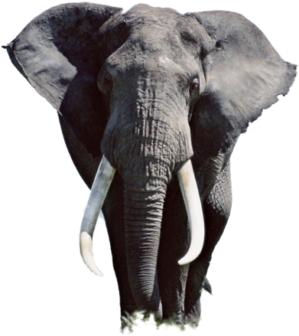
Some of the animals below are mammals. Some are not.
Cross out the animals that are not mammals
Elephant is the largest land mammal.

Slide 14
Some of the animals below are mammals. Some are not.
Cross out the animals that are not mammals
Horse is a mammal. The young one of a horse is called as colt.

Slide 15

Some of the animals below are mammals. Some are not.
Cross out the animals that are not mammals
Humans are the most intelligent mammal.

Slide 16
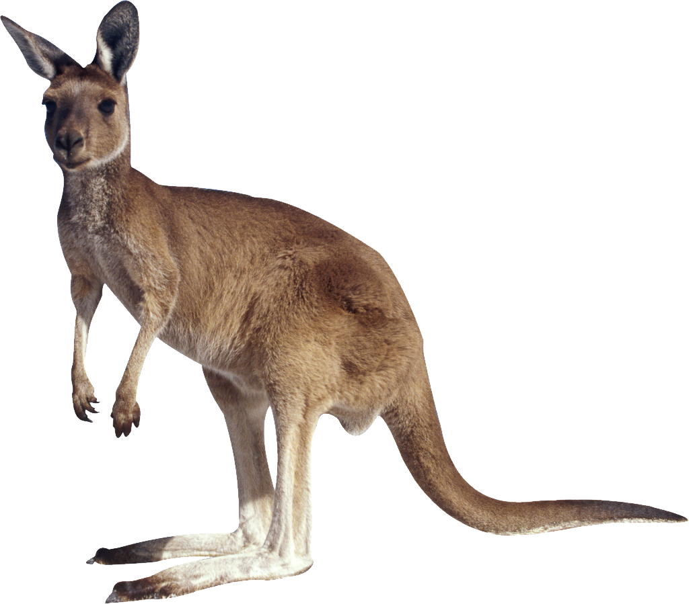
Some of the animals below are mammals. Some are not.
Cross out the animals that are not mammals
Kangaroo is a mammal. Kangaroo do not walk, it jumps everywhere.

Slide 17
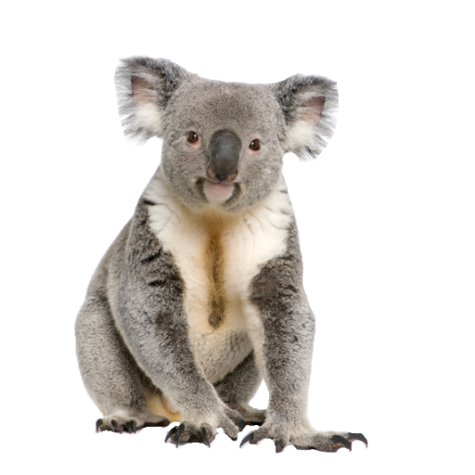
Some of the animals below are mammals. Some are not.
Cross out the animals that are not mammals
Koala is a mammal. Just like kangaroo even koala also keeps the young one in their pouch.

Slide 18
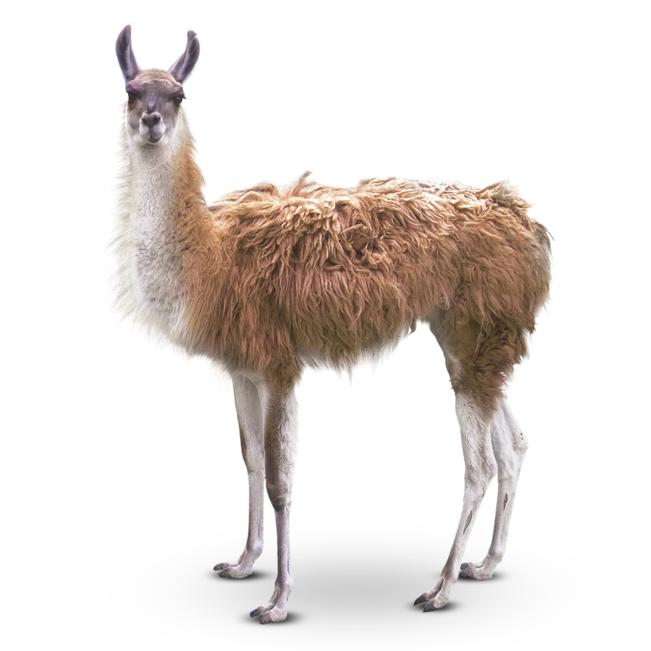
Some of the animals below are mammals. Some are not.
Cross out the animals that are not mammals
It is a mammal. Llamas communicate by humming.

Slide 19
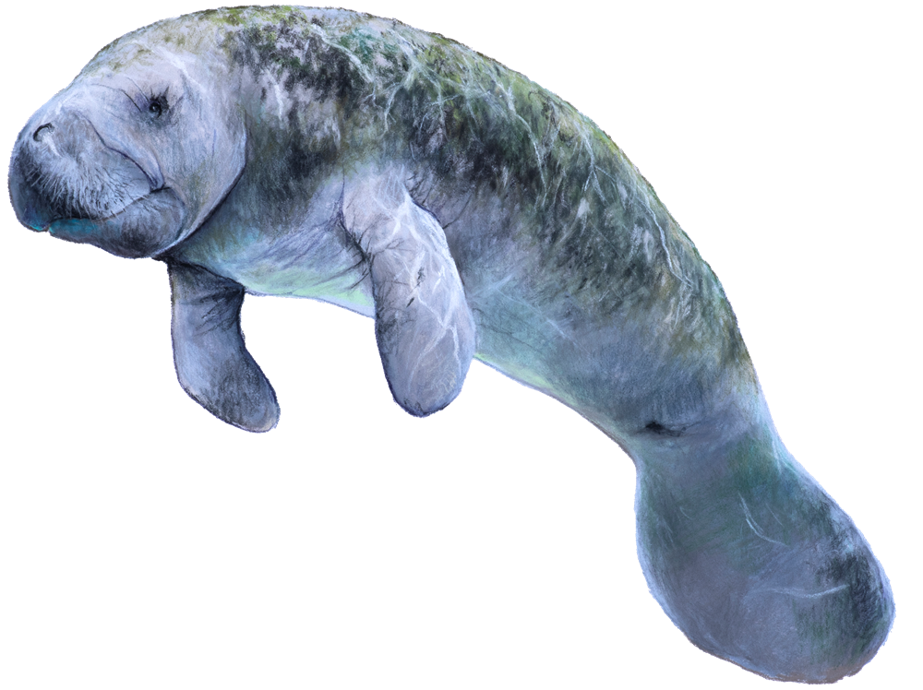
Some of the animals below are mammals. Some are not.
Cross out the animals that are not mammals
It is a sea mammal. It is also called as sea cow.

Slide 20
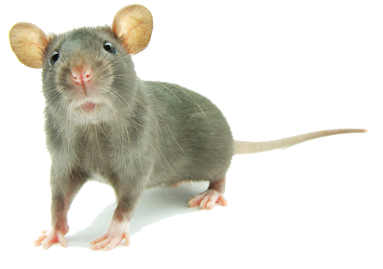
Some of the animals below are mammals. Some are not.
Cross out the animals that are not mammals
Mouse is a mammal. Plural of mouse is mice.

Slide 21
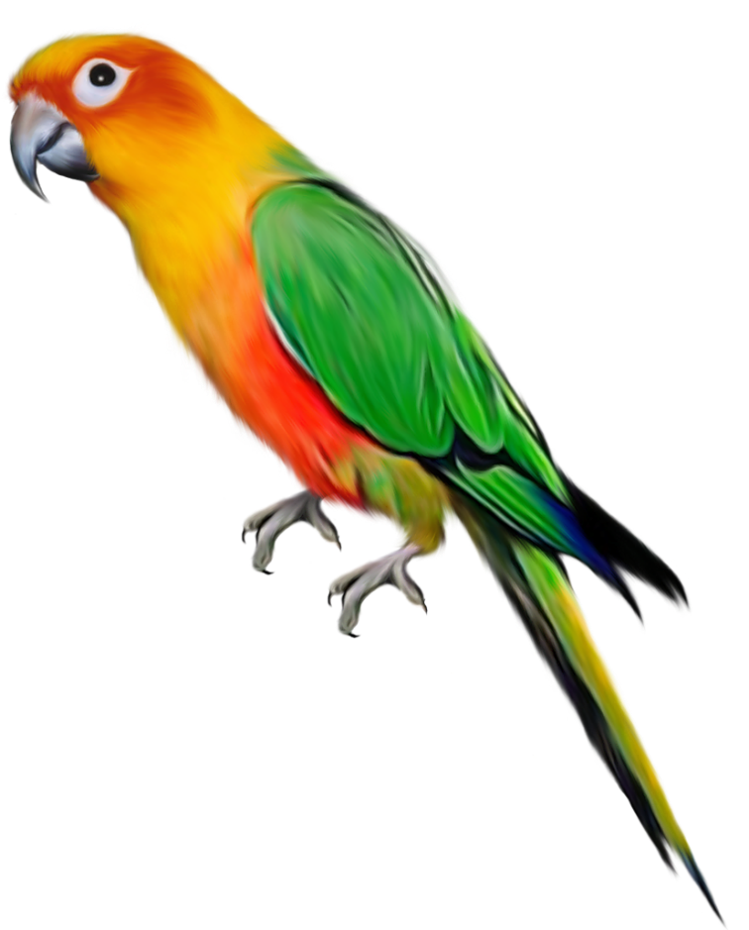
Some of the animals below are mammals. Some are not.
Cross out the animals that are not mammals
Parrot is a bird.

Slide 22
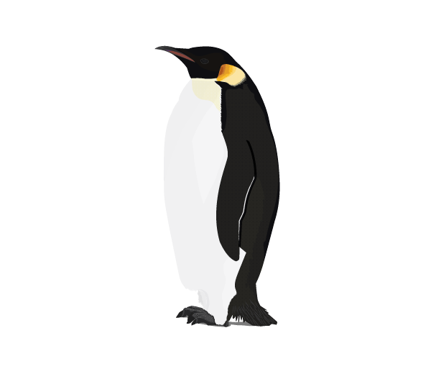
Some of the animals below are mammals. Some are not.
Cross out the animals that are not mammals
Penguin is a bird.

Slide 23
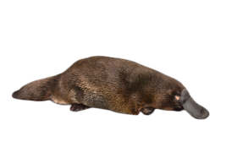
Some of the animals below are mammals. Some are not.
Cross out the animals that are not mammals
Platypus is a mammal. It lays egg. It is a semi aquatic animals which has webbed feet.

Slide 24
Some of the animals below are mammals. Some are not.
Cross out the animals that are not mammals
Polar bear is a mammal. It has 42 teeth.

Slide 25
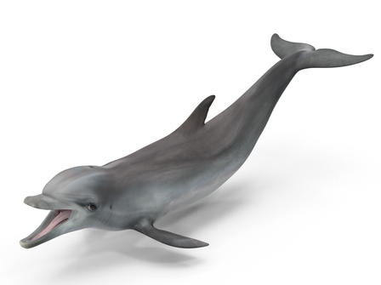
Some of the animals below are mammals. Some are not.
Cross out the animals that are not mammals
Porpoises and dolphins have similar appearance, but a porpoise is usually smaller and chubbier than a dolphin. They are small toothed whales. Porpoise is a mammal.

Slide 26
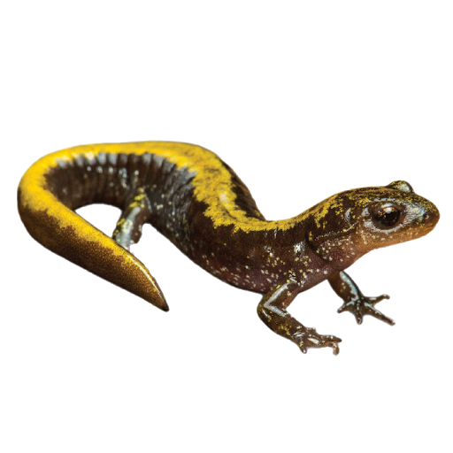
Some of the animals below are mammals. Some are not.
Cross out the animals that are not mammals
Salamander lives both in land and water. It lays egg on the water. It is not a mammal, it is an amphibian.

Slide 27
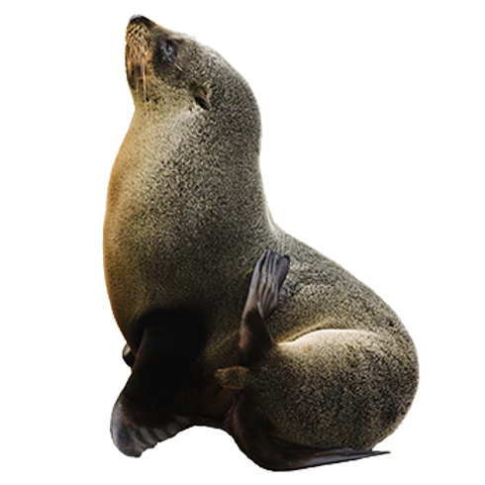
Some of the animals below are mammals. Some are not.
Cross out the animals that are not mammals
Seal is a mammal. Seal do not have any legs. Instead they have four flippers.

Slide 28
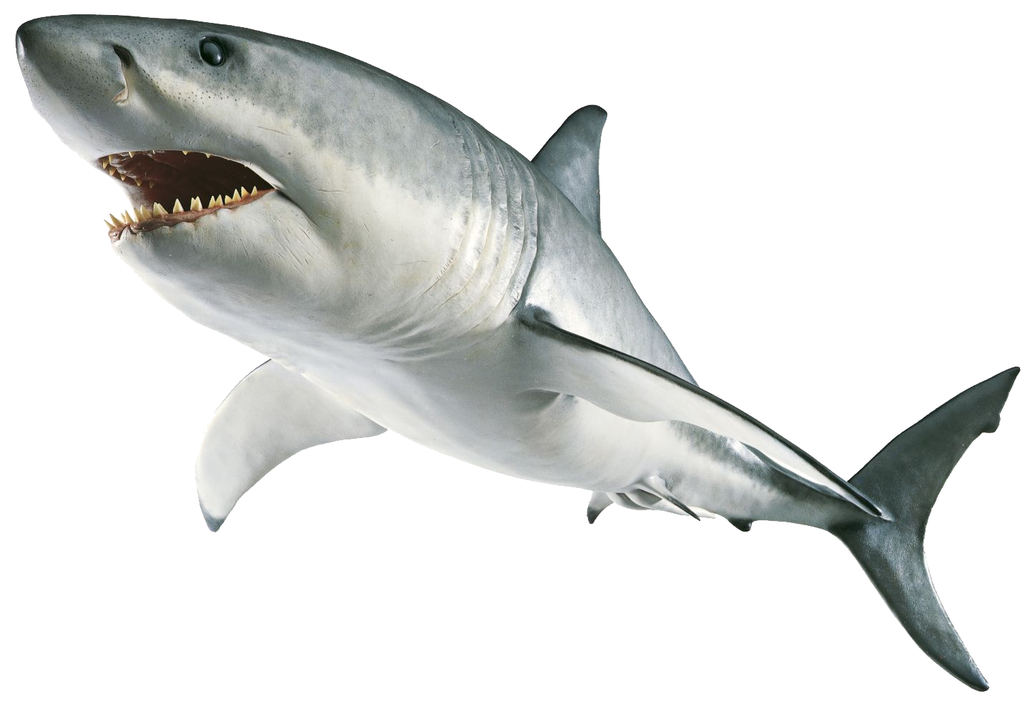
Some of the animals below are mammals. Some are not.
Cross out the animals that are not mammals
Shark is an aquatic animal that lays egg. It breathe through gills. It is a fish not a mammal.

Slide 29
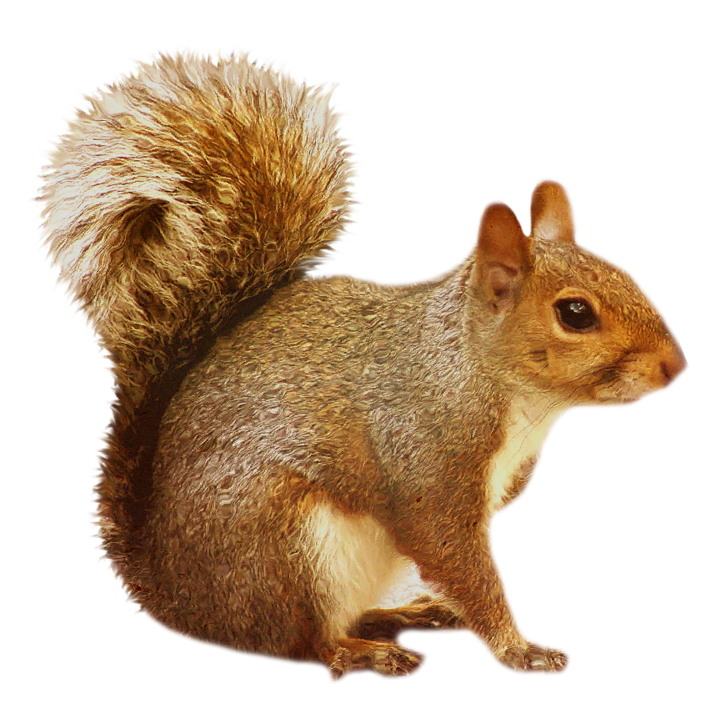
Some of the animals below are mammals. Some are not.
Cross out the animals that are not mammals
Squirrel is a mammal. Squirrels live on all continents except Australia and Antarctica.

Slide 30
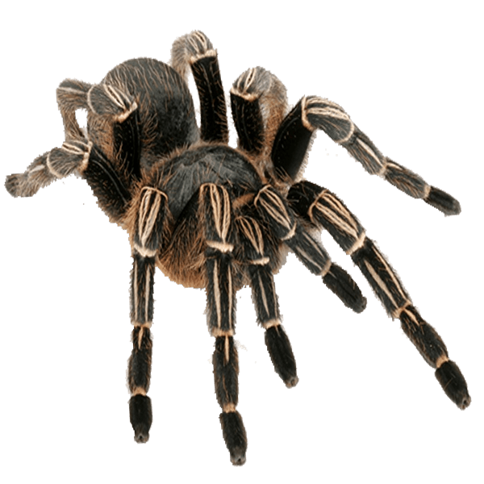
Some of the animals below are mammals. Some are not.
Cross out the animals that are not mammals
Tarantula is a type of spider. It is an invertebrate.

Slide 31
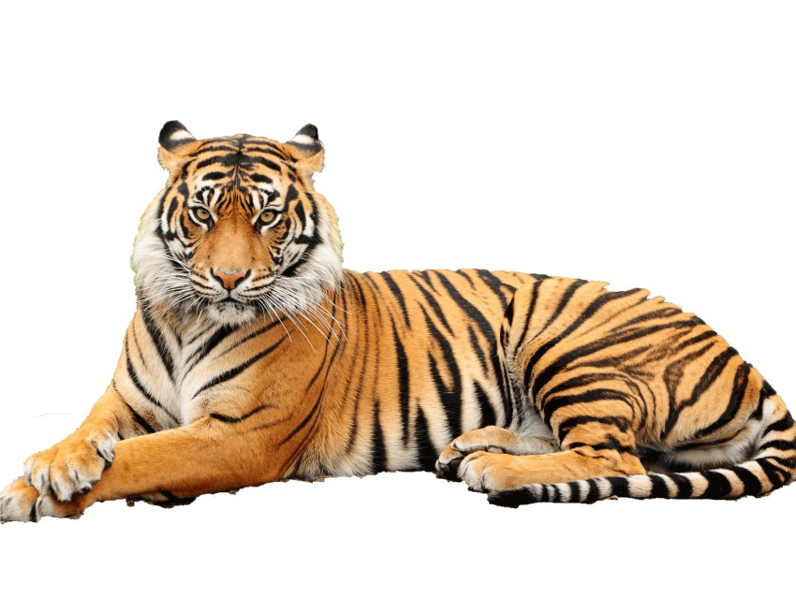
Some of the animals below are mammals. Some are not.
Cross out the animals that are not mammals
Tiger is a mammal. Tiger is a nocturnal animal.

Slide 32
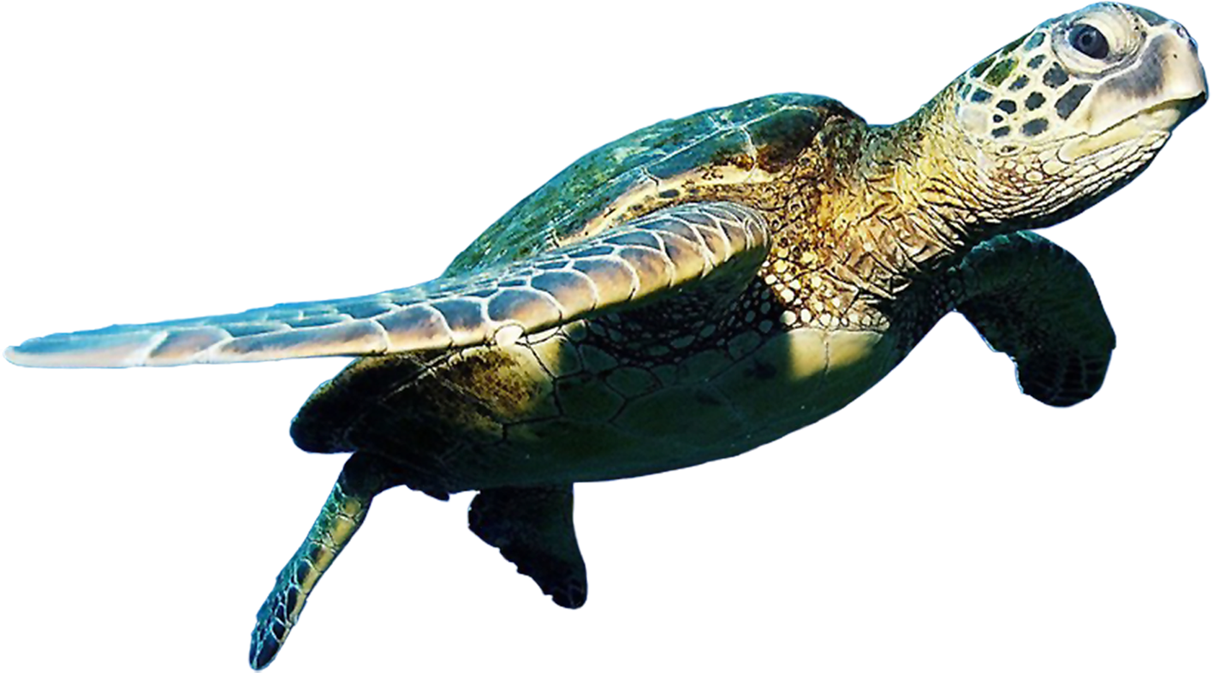
Some of the animals below are mammals. Some are not.
Cross out the animals that are not mammals
Turtle is a reptile. It is not a mammal.

Slide 33
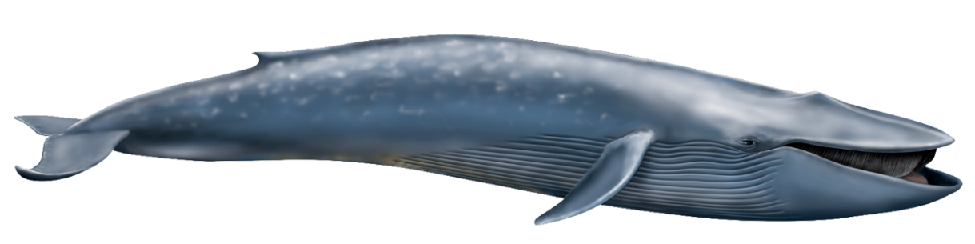
Some of the animals below are mammals. Some are not.
Cross out the animals that are not mammals
Whale is a mammal. Blue whale is the biggest mammal.

Slide 34
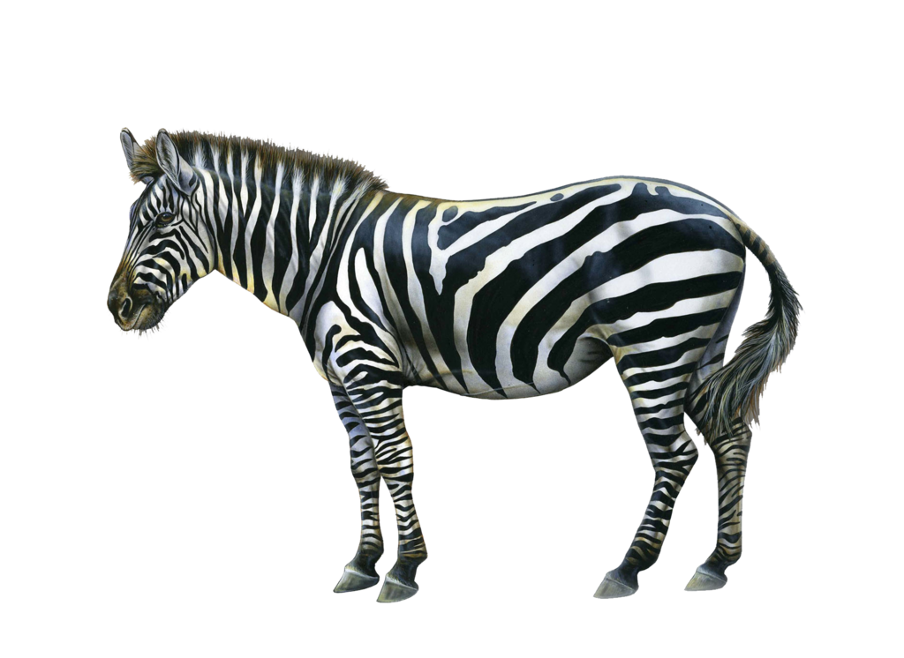
Some of the animals below are mammals. Some are not.
Cross out the animals that are not mammals
Zebra is a mammal. Every zebra has a unique pattern of black and white stripes.

Slide 35

Homework
EVS 1A Workbook
Page 63

